Slide 1
CSCI 360 Presentation
Gordon Zheng, Kevin Li, Ismail Kheir, Ahtsham Gulraiz

Slide 2
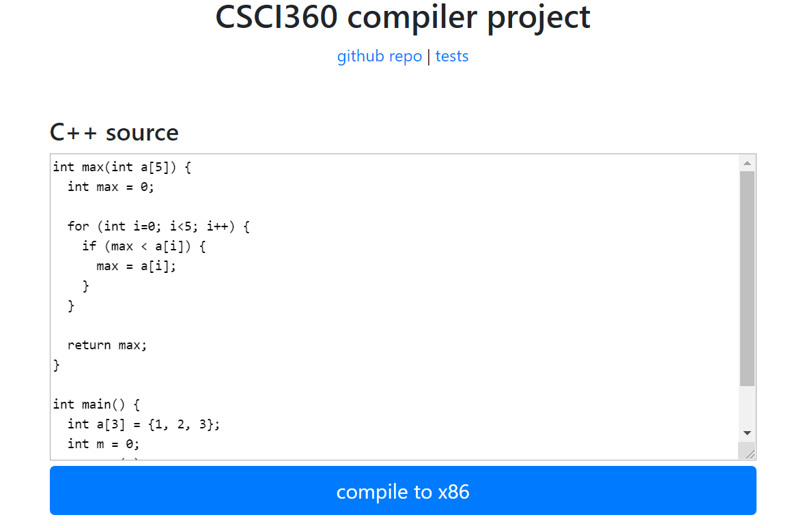
Recap: Input Field

Slide 3
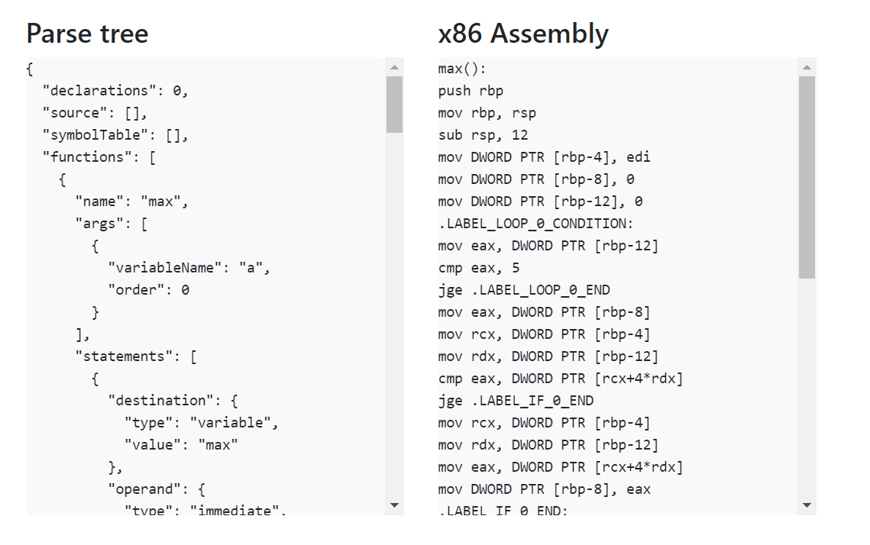
Recap: Parse Tree & Assembly

Slide 4
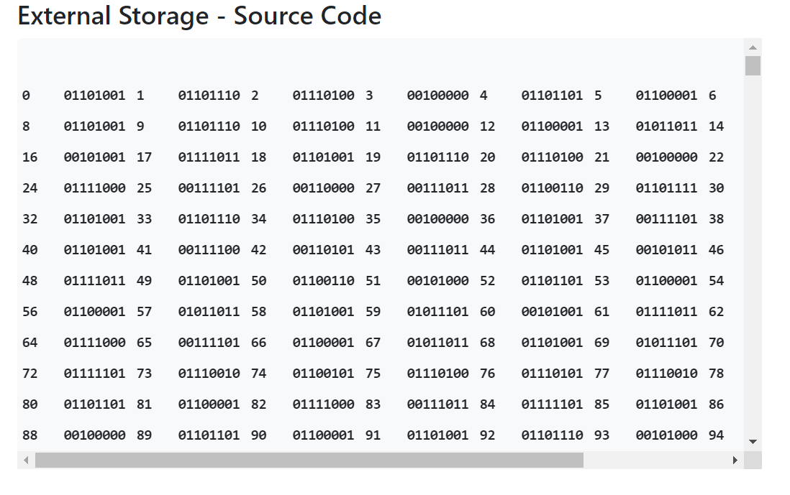
Recap: External Storage

Slide 5
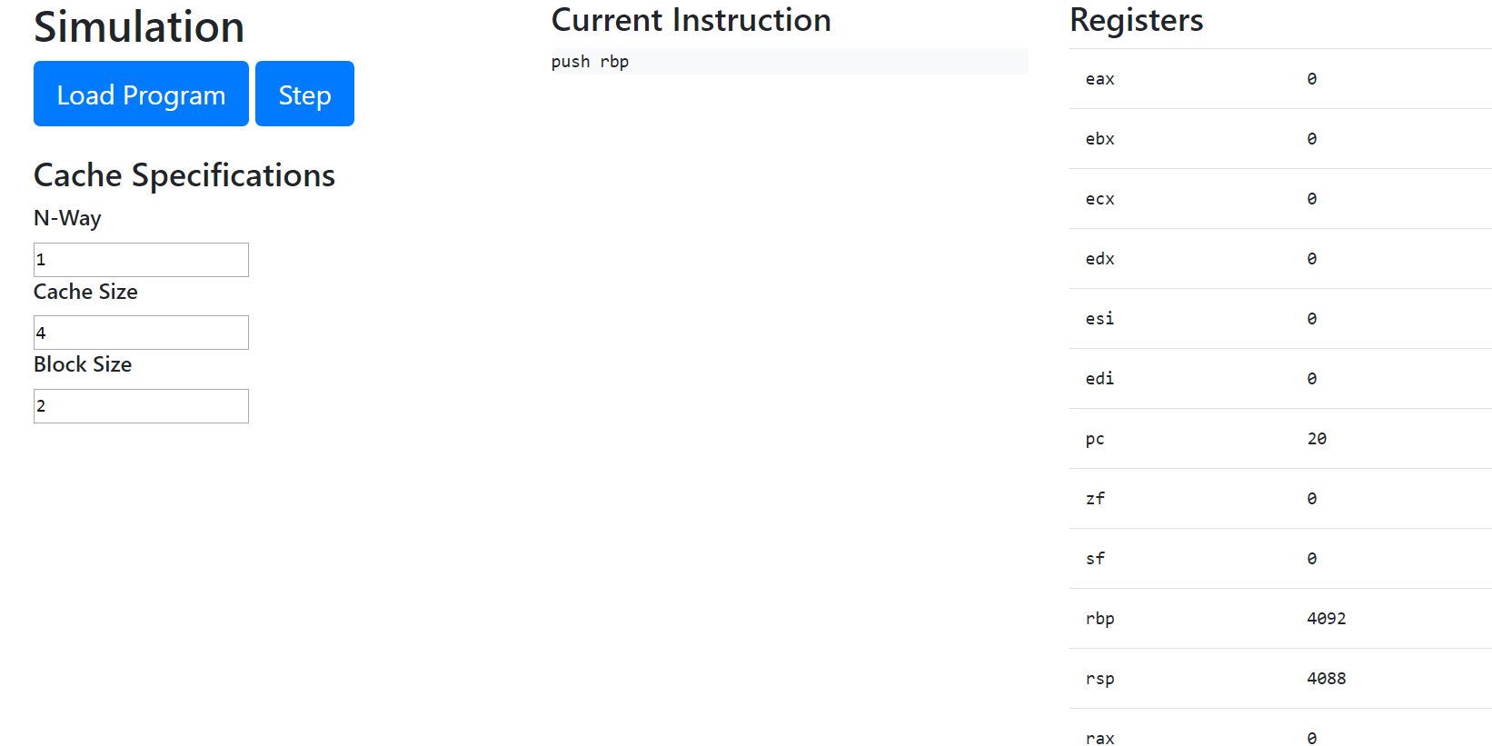
Simulation Overview & Registers

Slide 6
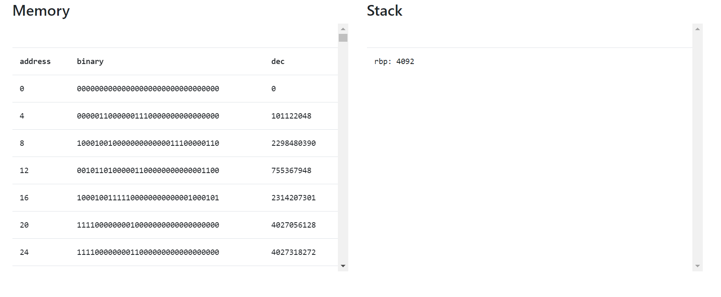
Simulation: Physical Memory & Call Stack

Slide 7
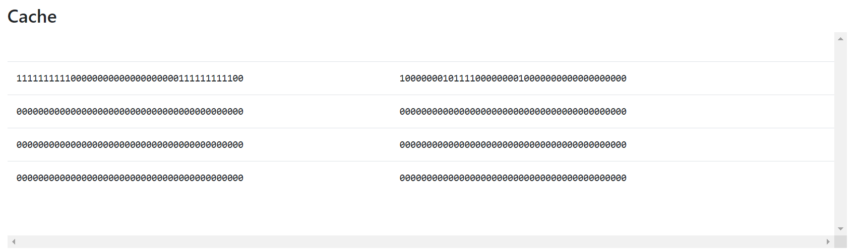
Simulation: Cache (nway: 2, size: 4, k: 1)

Slide 8
Simulation: Statistics

